Slide 1
VDOE Mathematics Update
Virginia Council of Mathematics Specialists
Fall 2016 Conference – Culpeper, VA
VDOE Mathematics Team:
Christa Southall, Mathematics Specialist
Tina Mazzacane, Mathematics and Science Specialist
Debbie Delozier, Mathematics Specialist

Slide 2
VDOE Mathematics Update Agenda
2015-2016 Statewide Mathematics Assessment Results
Computer Adaptive Testing
TestNav 8 Implementation
Revision and Adoption Process -
  2016 Mathematics Standards of Learning and
  2016 Mathematics Curriculum Framework
Revised Introductory Statements
Reflection Page

Slide 3
2015-2016 Statewide Mathematics Assessment Results

Slide 4
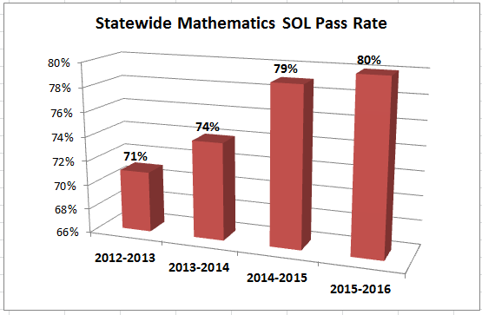
SOL Statewide Test Results

Slide 5
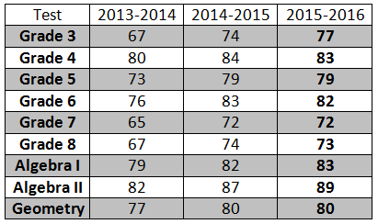
SOL Statewide Test Results (All Students)

Slide 6
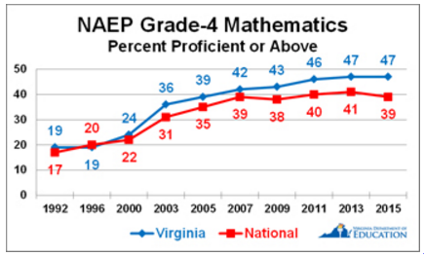
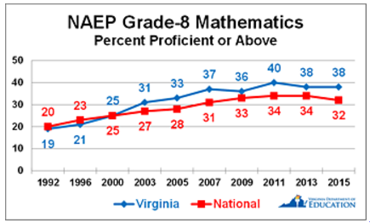
2015 Virginia Mathematics NAEP Results

Slide 7
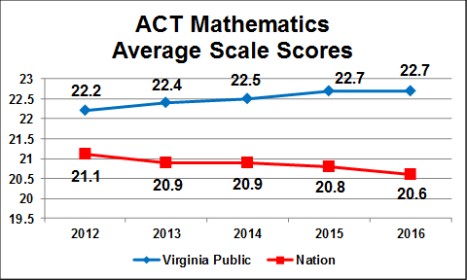
ACT Mathematics Results

Slide 8
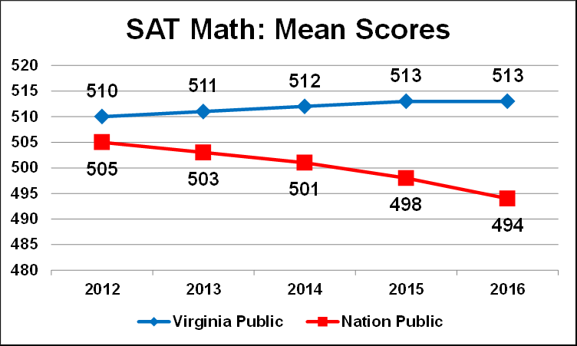
SAT Mathematics Results

Slide 9
Computer Adaptive Testing (CAT) and TestNav 8 Updates

Slide 10
Computer Adaptive Testing
Computer adaptive versions of SOL assessments for Grades 3 - 8 Mathematics will be administered in Spring 2017
CAT Resources
  Videos
  CAT Training Test - provides students with practice in navigating through a CAT prior to the actual test taking experience.
  Comparisons of CAT vs Traditional Tests
  FAQ about CAT

Slide 11
Transition from TestNav 7 to TestNav 8
Superintendent’s Memo #048-16
Introduction to TestNav 8: Multiple-Choice/Technology-Enhanced Item Tests – PDF guide provides an overview to TN8 and practice items

Slide 12
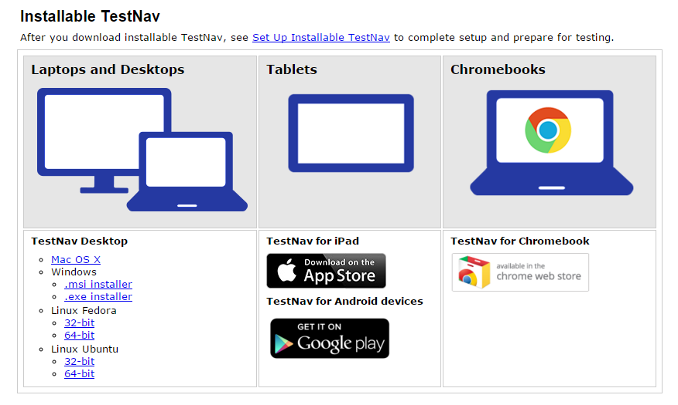
TestNav 8: Installable Application http://download.testnav.com/
Notes:
Reduces reliance on third-party software
Continues transition to cloud-based computing

Slide 13
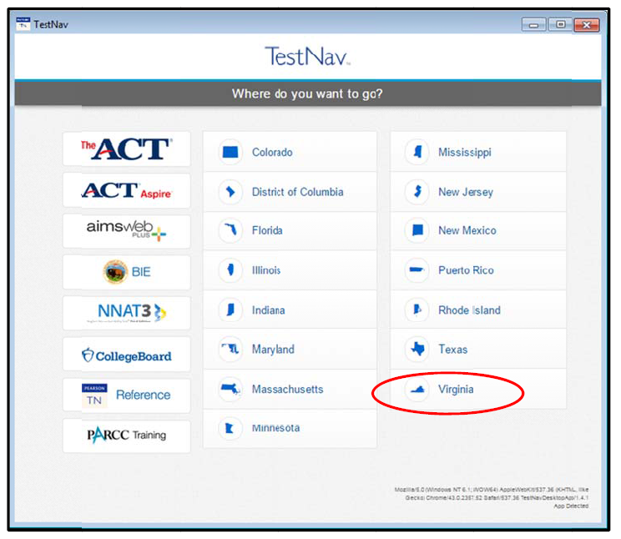
TestNav 8 Application

Slide 14
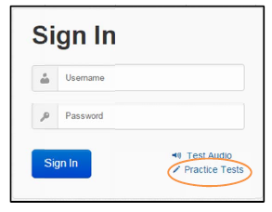
TestNav 8 Practice Items
NOTE: No Sign In (Username/Password) is needed to access Practice Tests from the TestNav 8 Application
Notes:
Will need to choose Virginia prior to getting to this screen; compare to the old ePat tests

Slide 15
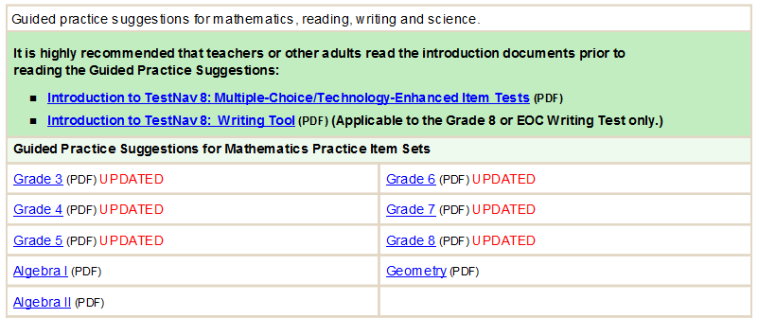
TestNav 8 Practice Item Guides
TestNav 8 Guided Practice Suggestions available in PDF for:
  Grades 3 – 8 Mathematics
  Algebra I, Geometry, and Algebra II

Slide 16
TestNav 8 Features
Utilizes Responsive Design concepts
  Items are no longer presented as static images.
  Item presentation will vary based on the type and size of device used for testing.
Supports the use of additional accessibility features
  Offers some new accessibility features for online Standards of Learning tests immediately.
  Provides a foundation for additional features in the future.
  Does not eliminate the need for existing special forms such as braille and large print test forms.
Notes:
Students can enlarge images. Sizing of images and the need for scrolling will depend on type of device.

Slide 17

TestNav 8 Mathematics Tools Practice
Mathematics Tools Practice will be updated to TestNav 8 for:
  Grades 3-8 Tools Practice
  End-of-Course Tools Practice

Slide 18
Important: Practice Items & Guides
Teachers need to read Introduction to TestNav 8: Multiple-Choice/Technology-Enhanced Item Tests
Students need to have experience with Mathematics Practice Item Sets, with teacher/adult using TestNav 8 Guided Practice Suggestions for the appropriate grade/course

Slide 19
Algebra Readiness Diagnostic Test (ARDT)
Diagnostic assessment administered to students that are identified as “at risk” of failing the Algebra I SOL
Those who are identified for remediation/intervention will also take a post-test following remediation/ intervention
Delayed administration dates for 2016-2017
  Testing window opening – anticipated late November
  Delay due to the necessary conversion from TestNav7.5 to TestNav8

Slide 20
2016 Standards Adoption and Implementation

Slide 21
Mathematics SOL Revision Process
March 2015 – BOE initiated Review Process
March 27-April 27, 2015 – Public comment period and committee applications received
June 2015 – Review committee met
November 2015 – Review by IHE, business community, and mathematics organizations
March 17, 2016 – First review by BOE (followed by public comment period and public hearings)
September 22, 2016 – BOE Approved 2016 Standards of Learning and 2016 Curriculum Framework
(for additional information see Superintendent’s Memo 244-16)

Slide 22
2009 Curve of Change Implementation
Progress
Past Practice
Denial
Acceptance
Anger
Understanding
Fear
Depression

Slide 23
2016 Curve of Change Implementation
Progress
Past Practice
Denial
Anger
Acceptance
Fear
Understanding
Depression

Slide 24
Anticipated Implementation Timeline
2016-2017 School Year – Curriculum Development VDOE staff provides a summary of the revisions to assist school divisions in incorporating the new standards into local written curricula for inclusion in the taught curricula during the 2017-2018 school year.
2017-2018 School Year – Crossover Year 2009 Mathematics Standards of Learning and 2016 Mathematics Standards of Learning are included in the written and taught curricula. Spring 2018 Standards of Learning assessments measure the 2009 Mathematics Standards of Learning and include field test items measuring the 2016 Mathematics Standards of Learning.
2018-2019 School Year – Full-Implementation Year Written and taught curricula reflect the 2016 Mathematics Standards of Learning. Standards of Learning assessments measure the 2016 Mathematics Standards of Learning.
Turn and Talk

Slide 25
Foci of Revisions
Improve the vertical progression of mathematics content
Ensure developmental appropriateness of student expectations
Increase support for teachers in mathematics content
Clarify expectations for teaching and learning
Improve precision and consistency in mathematical language and format
Ensure proficiency of elementary students in computational skills

Slide 26
Standards of Learning
2016 Mathematics Standards of Learning
  Introductory Statements
    Mathematical Process Goals for Students
    Instructional Technology (new)
    Computational Fluency (new)
    Algebra Readiness (new)
    Equity (new)
  Grade Level/Course Introduction
  Content Strands and Standards of Learning

Slide 27
Curriculum Framework
2016 Mathematics Standards of Learning Curriculum Frameworks
  Introductory statements
  Content strand overviews (K-8)
  Standards of Learning for the grade level or course
  Understanding the Standard – information that supports mathematics content knowledge
  Essential Knowledge and Skills – information that provides expectations for student learning

Slide 28
Mathematics Process Goals for Students
“The content of the mathematics standards is intended to support the five process goals for students”
- 2009 and 2016 Mathematics Standards of Learning
Mathematical Understanding
Problem Solving
Connections
Communication
Representations
Reasoning

Slide 29
Format Changes to the Curriculum Framework
Reduction of columns from 3 to 2
  consistency with other disciplines
  consistency within mathematics levels
Indicators of SOL sub-bullet added to each bullet within the Essential Knowledge and Skills
Indicator of objectives measured without a calculator on state assessments
Reduction in number of standards – many levels
Notes:
Reduction of number of standards does not mean less content – result of reorganization. Example – Grade 2 combining standards

Slide 30
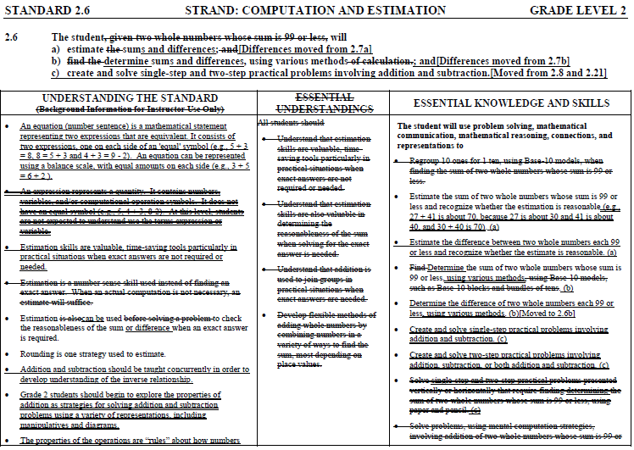
Notes:
Update example

Slide 31
Vertical Progression of Mathematics Content
Overall reduction in the number of standards from 285 to 259
Consolidation of related concepts and skills
  Reduction of repetition
  Improvement of the developmental progression
  Deletion of content

Slide 32
Grade Level | 2009 | 2016 | Change
K | 16 | 13 | -3
1 | 18 | 15 | -3
2 | 22 | 17 | -5
3 | 20 | 17 | -3
4 | 16 | 16 | 0
5 | 19 | 19 | 0
6 | 20 | 14 | -6
7 | 16 | 13 | -3
8 | 17 | 18 | 1
Algebra | 11 | 9 | -2
Geometry | 14 | 14 | 0
Algebra, Functions, and Data Analysis | 8 | 8 | 0
Algebra II | 12 | 12 | 0
Mathematical Analysis | 14 | 14 | 0
Probability & Statistics | 20 | 20 | 0
Discrete Mathematics | 13 | 13 | 0
Computer Mathematics | 20 | 18 | -2
Trigonometry | 9 | 9 | 0
 | 285 | 259 | -26
Reduction of 24

Slide 33
Support for Teachers
Significant additions to the Understanding the Standard column including
  Definitions
  Explanations
  Examples
  Instructional connections
Improvements in precision, clarity, and consistency in language K-12

Slide 34

Table Talk – Introductory Statements
Read excerpt from Introductory statements
Think about implications for your work
Round robin share out to discuss impacts on instruction with whole table
Notes:
Include the entire introduction document, but have each focus on a specific portion of each of the introductions

Slide 35
Instructional Technology
“The use of appropriate technology and the interpretation of the results from applying technology tools must be an integral part of teaching, learning, and assessment. However, facility in the use of technology shall not be regarded as a substitute for a student’s understanding of quantitative and algebraic concepts and relationships or for proficiency in basic computations.”

Slide 36

Computational Fluency
“Mathematics instruction must develop students’ conceptual understanding, computational fluency, and problem-solving skills. The development of related conceptual understanding and computational skills should be balanced and intertwined, each supporting the other and reinforcing learning. Computational fluency refers to having flexible, efficient and accurate methods for computing. Students exhibit computational fluency when they demonstrate strategic thinking and flexibility in the computational methods they choose, understand and can explain, and produce accurate answers efficiently.”

Slide 37
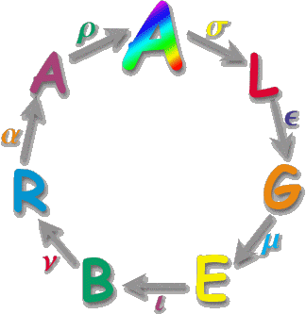
Algebra Readiness
““Algebra readiness” describes the mastery of, and the ability to apply, the Mathematics Standards of Learning, including the Mathematical Process Goals for Students, for kindergarten through grade 8. The study of algebraic thinking begins in kindergarten and is progressively formalized prior to the study of the algebraic content found in the Algebra I Standards of Learning.”

Slide 38
Algebra Readiness
Introduction to the 2009 Grade 7 Mathematics SOL
  “Students who successfully complete the seventh-grade standards should be prepared to study Algebra I in grade eight.”
Replaced with an introductory paragraph
  ““Algebra readiness” describes the mastery of, and the ability to apply, the Mathematics Standards of Learning, including the Mathematical Process Goals for Students, for kindergarten through grade 8.”
REMOVED

Slide 39

Equity
“Mathematics programs should have an expectation of equity by providing all students access to quality mathematics instruction and offerings that are responsive to and respectful of students’ prior experiences, talents, interests, and cultural perspectives. Successful mathematics programs challenge students to maximize their academic potential and provide consistent monitoring, support, and encouragement to ensure success for all.”

Slide 40
Overview of 2016 Crosswalk
(Summary of Revisions) Documents

Slide 41
Overview of Crosswalk Documents
By grade level/course
Includes:
  Additions
  Deletions
  Parameter changes/
  clarifications (2016 SOL)
  Moves within the grade level (2009 SOL to 2016 SOL)
Additions (2016) | Deletions (2009)
Parameter Changes (2016) | Moves (2009 to 2016)

Slide 42
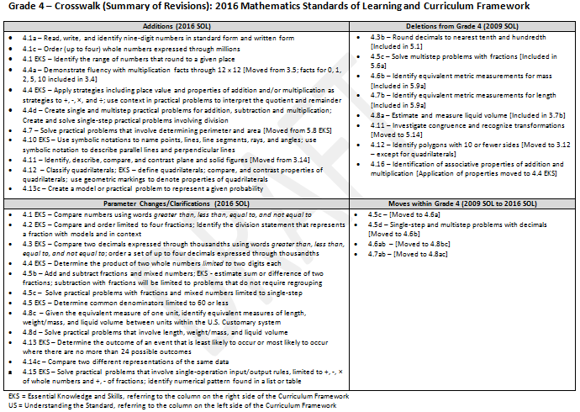
Grade Level Summary of Revisions
Notes:
NEED TO UPDATE SLIDE

Slide 43
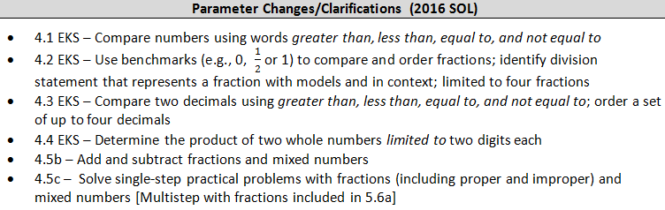
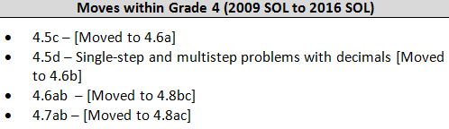
2009
2016

Slide 44
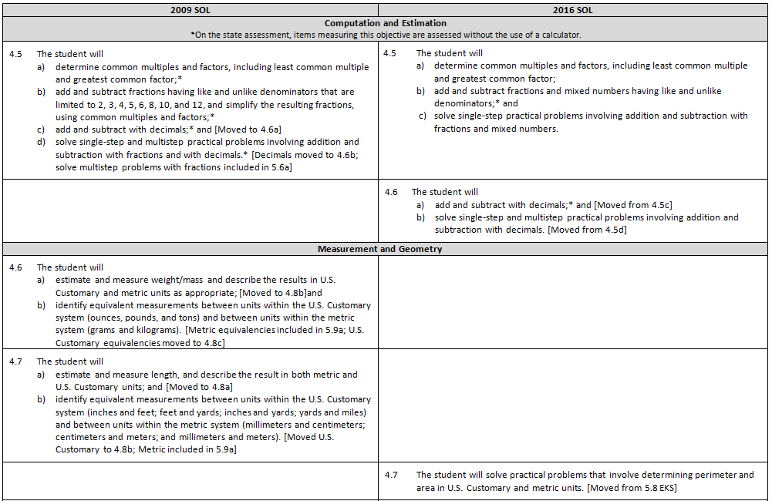

Slide 45
Grades K-2
2016 Standards of Learning and Curriculum Framework Revisions

Slide 46
Grades K-2 Revision Highlights Agenda
K-2 Crosswalk Review
Explore the Structure of Problems
  Video from IES – What Works Clearinghouse
  Problem Type Exploration
  Sharing and Reflection
Notes:
http://www.ies.ed.gov/ncee/wwc/PracticeGuide/2

Slide 47
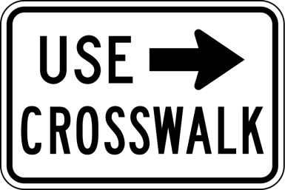
Explore Changes and Potential Implications
Distribute the grade level crosswalk summaries so that there are an equal number of representatives for each grade level (grade level experts)
Individually review your grade level summary and make notes
  Identify significant changes at each grade level
  Consider pedagogical or content challenges that
  may require additional teacher support
Table top discussion
  Each team of grade level experts shares significant changes and potential challenges
  Group looks for content connections across grade levels
  Discuss areas where teachers will need additional support
  Share strategies for supporting teachers with these revisions (consider who you need to consult/when and what will be your next steps)
Notes:
Approx 3 copies for each grade level/per table

Slide 48


Kindergarten Revision Highlights
Greater focus on number sense and part-whole relationships
Recognize and describe with fluency part-whole relationships for numbers to 5
Investigate part-whole relationships for numbers to 10
Identify number after, without counting, when given any number between 0 and 100
Identify the number before, without counting, when given any number between 1 and 10
Investigate fractions by representing and solving practical problems involving two equal shares
Time to hour, count by fives, value of collection of pennies or nickels, tallying (included in grade 1)

Slide 49

Grade 1 Revision Highlights
Greater focus on number sense and part-whole relationships
Compare two numbers between 0 and 110
Count and represent numbers increased from 100 to 110
Count forward orally, by ones, to 110, starting at any number between 0 and 110
Indicate ordinal positions first through tenth
Recognize/describe with fluency part-whole relationships with numbers up to 10
Create and solve problems with addition and subtraction increased from 18 to 20; explain strategies
Combine parts contained in larger numbers up to 20 by using related combinations
Determine the value of a collection of like coins (pennies, nickels, or dimes); value of a collection of pennies, nickels and dimes [Included in 2.10a]

Slide 50
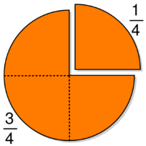
Grade 2 Revision Highlights
Identify the number that is 10 more, 10 less, 100 more, or 100 less than a given number up to 999
Order three whole numbers between 0 and 999 represented with concrete objects, pictorially, or symbolically
Increase skip counting from 100 to 120; includes counting by various multiples of 2, 5, 10
Count and compare fraction pieces to one whole
Fluency with addition and subtraction facts increased from 18 to 20
Measurement limited to
  length to nearest inch
  Weight to nearest pound
  Temperature in Fahrenheit to nearest ten degrees
Statistics – Data points collected by students (limited to 16 with no more than 4 categories); read and interpret data represented in pictographs and bar graphs with up to 25 data points and no more than 6 categories

Slide 51
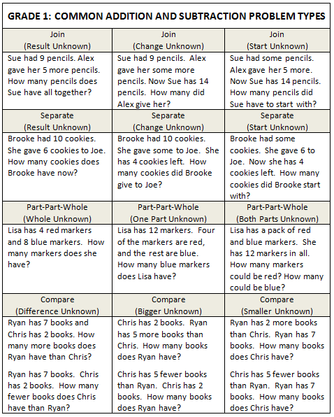
Exploring the Structure of Problems
Problem structure charts have been included in the curriculum frameworks
Instruction should include solving word problems based on common underlying structures
  Video - Assisting Students Struggling with Mathematics: Response to Intervention (RtI) Recommendation #4
Gersten, R, et. Al. (2009) Assisting students struggling with mathematics: Response to intervention (RtI) for elementary and middle schools (NCEE 2009-4060). Washington, DC: USDOE.
Notes:
View video; what works clearinghouse
We’ll take a look at grade one

Slide 52
Exploring Problem Structures
TASK:
Divide up the problem types among your group (Join, Separate, Part-part-whole, and Compare)
Work alone or with a partner
Match the numbers in each problem with the components of the problem structure (i.e., which number in each problem is the start, which is the result, which is the change)
Using the materials at your table, model and solve the problems as a first grader
Represent the problem you modeled with an addition or subtraction equation
Adapted from: Van de Walle, J.A., Karp, K.S., Lovin, L.H. & Bay-Williams, J.M. (2014, 131). Teaching Student-Centered Mathematics: Developmentally Appropriate Instruction for Grades K-2 (2nd ed.). (Vol. II). Pearson Education Inc.

Slide 53
Problem Type Sharing and Reflection
Table top discussion:
  Share and compare your work with others
  Rank order the problem types according to the problems from least difficult to most difficult
Whole group:
  What are some ways you might utilize this information?
  How might it be shared with teachers in your school/district?

Slide 54
Grades 3-5
2016 Standards of Learning and Curriculum Framework Revisions

Slide 55
Grades 3-5 Revision Highlights Agenda
Grade Level Crosswalk Review
Grades 3-5 “Triad” Sharing
Identify Potential Challenges and Supports for Instruction
  Roundtable Brainstorm
  Gallery Walk
  Whole group – Next Steps
Notes:
http://www.ies.ed.gov/ncee/wwc/PracticeGuide/2

Slide 56
Explore Changes and Potential Implications in Grades 3-5
Each table receives one grade level crosswalk (summary of revisions)
As a group
  Identify the potential pedagogical and/or content challenges
  Discuss areas where teachers will need additional support
  Brainstorm strategies for supporting teachers with these revisions (consider who you need to consult/when and what will be your next steps)
  Be prepared to share ideas with others
Notes:
Approx 3 copies for each grade level/per table

Slide 57


Explore Changes and Potential Implications
Form a “rainbow” triad representing each level in the grade band. Spend 10-15 minutes:
  Share significant changes at each grade level.
  Look for connections between the grades.
  Discuss areas where additional instructional support may be needed.
    What types of support may be needed?
    In what ways will you be able to assist?
  What supports might you need? From who? When?

Slide 58
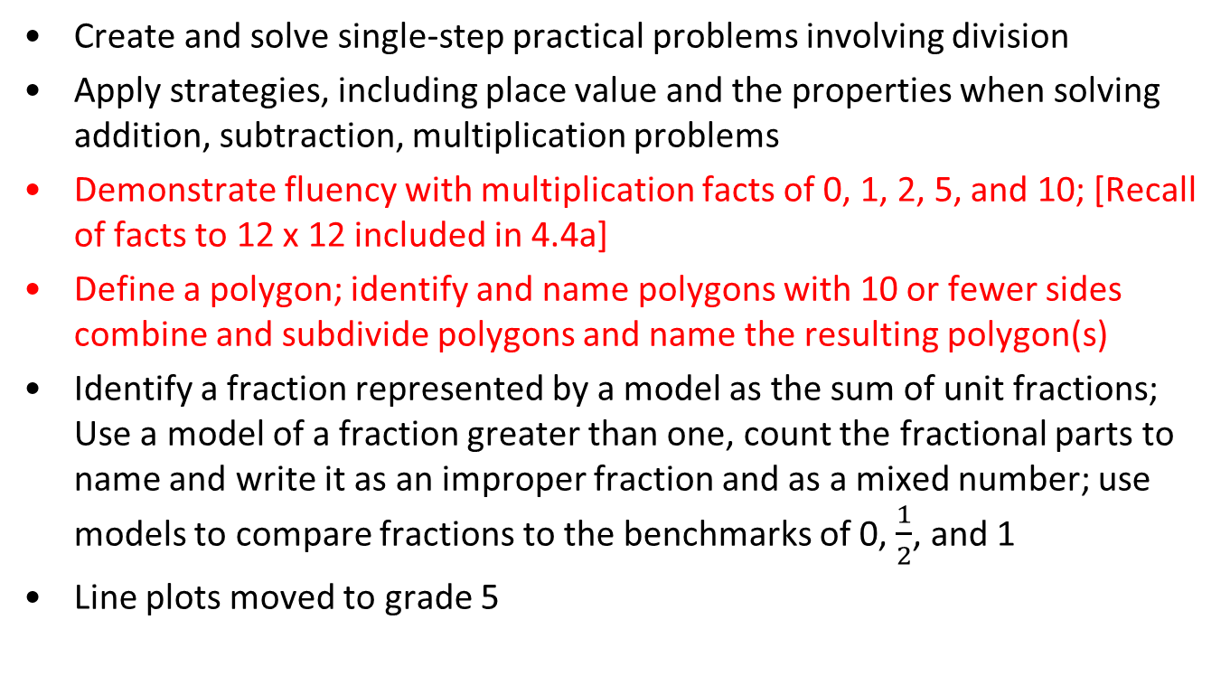
Grade 3 Revision Highlights
Create and solve single-step practical problems involving division
Apply strategies, including place value and the properties when solving addition, subtraction, multiplication problems
Demonstrate fluency with multiplication facts of 0, 1, 2, 5, and 10; [Recall of facts to 12 x 12 included in 4.4a]
Define a polygon; identify and name polygons with 10 or fewer sides combine and subdivide polygons and name the resulting polygon(s)
Identify a fraction represented by a model as the sum of unit fractions; Use a model of a fraction greater than one, count the fractional parts to name and write it as an improper fraction and as a mixed number; use models to compare fractions to the benchmarks of 0, $\frac{1}{2}$, and 1
Line plots moved to grade 5

Slide 59
Grade 4 Revision Highlights
Place value extended to nine-digit numbers
Demonstrate fluency with multiplication facts through 12 x 12 [Facts for 0, 1, 2, 5, 10 included in 3.4]
Apply strategies including place value and properties of addition and/or multiplication as strategies to +, -, ×, and ÷; use context in practical problems to interpret the quotient and remainder
Create single and multistep practical problems for addition, subtraction and multiplication; Create and solve single-step involving division
Solve practical problems that involve determining perimeter and area
Identify, describe, compare, and contrast plane and solid figures
Classify quadrilaterals; define quadrilaterals; compare, and contrast properties of quadrilaterals; use geometric markings to denote properties of quadrilaterals
Create a model or practical problem to represent a given probability

Slide 60
Grade 5 Revision Highlights
Divide with decimal dividend and decimal divisor
Model multiplication and division of decimals and whole numbers
Solve single-step practical problems involving multiplication of a whole number, limited to 12 or less, and a proper fraction, with models
Given the equivalent measure of one unit, identify equivalent metric measurements
Compare and contrast properties of triangles; use geometric markings
Investigate sum of the interior angles in a triangle and determine the unknown measure; EKS – Use models to prove the sum of the interior angles of a triangle is 180° and use the relationship to determine unknown angle measure in a triangle
Recognize and apply transformations
Determine probability using Fundamental Counting Principle
Represent and interpret data in a line plot

Slide 61

Grade Level – Placemat Brainstorm
Use chart paper, place on table, draw a circle in the middle:
Refer to the highlighted sections of the SOL/CF pages provided.
In the center, identify/record the pedagogical/content challenges associated with the changes.
Around the outside of the center, each team member records strategies or actions that will be help address these challenges.
Group sharing – “One Strays”
Team chooses one person to travel with their chart.
“One strays” visits a new table to share the challenges and potential strategies with another table.
Visit another table as time allows.
Notes:
Return to original table group; assign three different grade levels to one another

Slide 62
Grades 6-8 and Algebra I
2016 Standards of Learning and Curriculum Framework Revisions

Slide 63
Grades 6-8 & Algebra I Revision Highlights Agenda
6-8 & Algebra I Crosswalk Activity
Algebra I Equation Activity
Explore Patterns, Functions and Algebra 6-8
Notes:
http://www.ies.ed.gov/ncee/wwc/PracticeGuide/2

Slide 64
Grades 6-8 & Algebra I SOL True or False? Activity
Spend 5-8 minutes reviewing Crosswalk (Summary of Revisions) provided
Create groups of 4 at your table –
  Grade 6 Crosswalk expert
  Grade 7 Crosswalk expert
  Grade 8 Crosswalk expert
  Algebra I Crosswalk expert
Spend 10 minutes to complete the 2016 Grades 6 – 8 & Algebra I SOL True or False? Activity
When finished, share with others at your table

Slide 65
Grades 6-8 & Algebra I SOL True or False? Activity
Review the Activity KEY provided
Discuss the following as a table group:
  What connections exists between the grades?
  In what areas will teachers need the most support? What types of support?
  In what ways will you be able to assist?
    What supports might you need? From who? When?

Slide 66
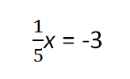





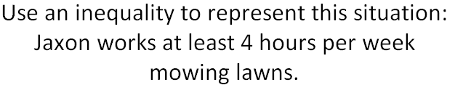
Grades 6-8 & Algebra I Equation Activity
Grade 6
Grade 7
Grade 7
Grade 8
Grade 8
Algebra I
Grade 6
Notes:
Grade 7

Slide 67
2009 Patterns, Functions and Algebra
7.12 The student will represent relationships
with tables, graphs, rules, and words.
8.14 The student will make connections
between any two representations
(tables, graphs, words, and rules) of a
given relationship.

Slide 68
Grades 6 Patterns, Functions and Algebra
SOL 6.12 The student will
represent proportional relationships between two quantities
determine the unit rate of a proportional relationship and use it to find the missing value in a ratio table
determine if a proportional relationship exists between two quantities; and
make connections between and among representations of a proportional relationship between two quantities using verbal descriptions, ratio tables, and graphs.

Slide 69
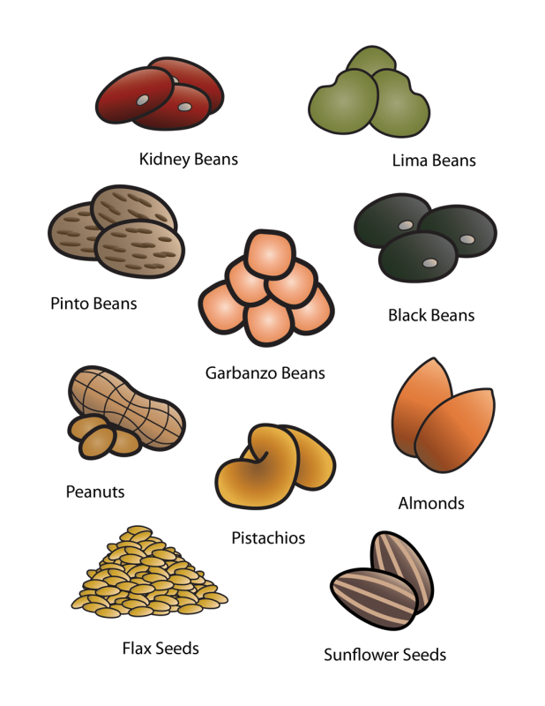
Grades 6 Patterns, Functions and Algebra
At a whole foods store, it costs $6 for every two pounds of pinto beans.
Create a ratio table that includes three additional equivalent ratios that represent this situation.
Use a verbal description to describe each equivalent ratio.
Find the unit rate (cost per pound) of pinto beans.

Slide 70
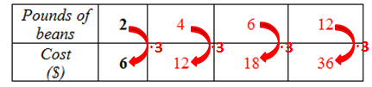
Grades 6 Patterns, Functions and Algebra
a)
b) The cost is $12 for 4 pounds of beans.
The cost is $18 for 6 pounds of beans.
The cost is $36 for 12 pounds of beans.
The unit rate for this proportional relationship would be $3 per pound. The
cost would result from $3 multiplied by the number of pounds of beans
purchased.

Slide 71
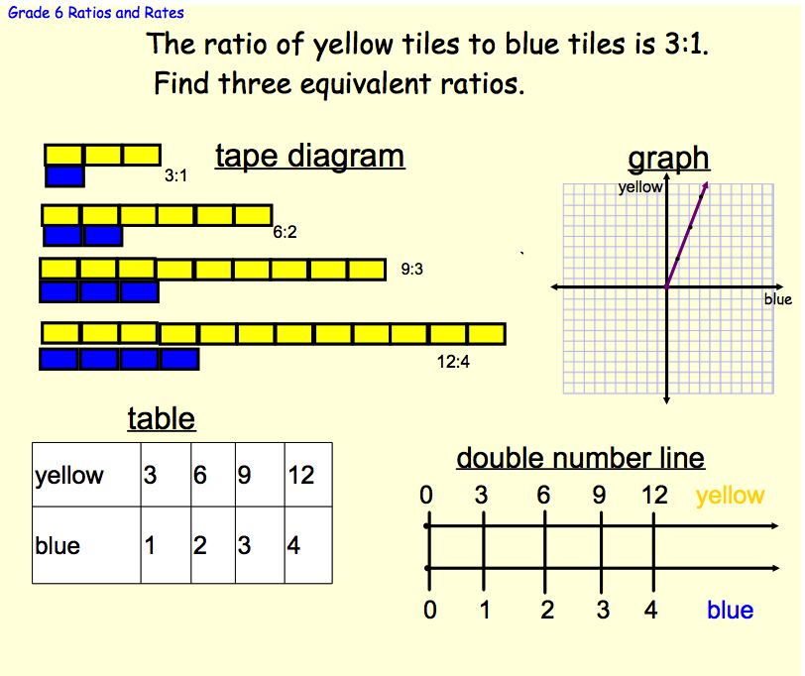
Proportional Relationships – Multiple Representations

Slide 72
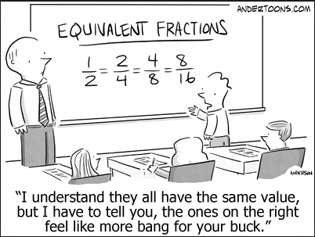

Slide 73
Grade 7 Patterns, Functions and Algebra
SOL 7.10 The student will
determine the slope, m, as rate of change in a proportional relationship between two quantities and write an equation in the form y = mx to represent the relationship;
Graph a line representing a proportional relationship between two quantities given the slope and an ordered pair, or given the equation in y = mx form, where m represents the slope as rate of change;
determine the y-intercept, b, in an additive relationship between two quantities and write an equation in the form y = x + b to represent the relationship;
Graph a line representing an additive relationship between two quantities given the y-intercept and an ordered pair, or given the equation in the form y = x + b, where b represents the y-intercept; and
Make connections between and among representations of a proportional or additive relationship between two quantities using verbal descriptions, tables, equations, or graphs.

Slide 74
Grade 7 Patterns, Functions and Algebra
The ordered pairs
(6, 1.5), (10, 2.5), (20, 5), and (24, 6)
make up points included in a proportional relationship.
Determine the rate of change, or slope, of a line passing through these points.
Write the equation of the line that represents the proportional relationship of y to x.

Slide 75


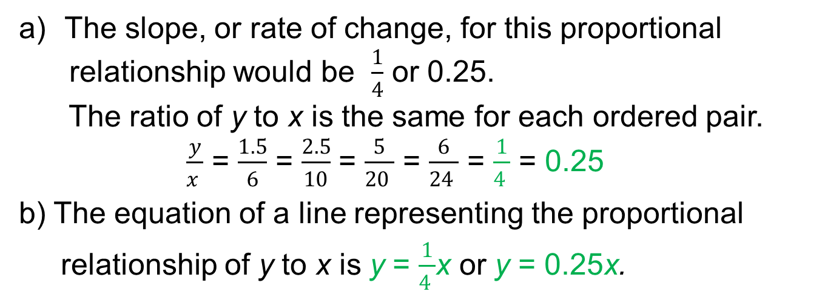



Grade 7 Patterns, Functions and Algebra
·$\frac{1}{4}$
·$\frac{1}{4}$
·$\frac{1}{4}$
·$\frac{1}{4}$
The slope, or rate of change, for this proportional
relationship would be $\frac{1}{4}$ or 0.25.
The ratio of y to x is the same for each ordered pair.
$\frac{y}{x }$ = $\frac{1.5}{6}$ = $\frac{2.5}{10}$ = $\frac{5}{20 }$ = $\frac{6}{24 }$ = $\frac{1}{4 }$ = 0.25
b) The equation of a line representing the proportional
relationship of y to x is y = $\frac{1}{4 }$x or y = 0.25x.

Slide 76
Grade 7 Patterns, Functions and Algebra
Owen is 4 years younger than his sister, Stephanie. Write an equation to represent the additive relationship between Stephanie’s age, x, and Owen’s age, y.

Slide 77

Grade 7 Patterns, Functions and Algebra
- 4
- 4
- 4
- 4
To find the additive value in this situation, we can find the differences between y and x for each pair of quantities. That is,
8 – 4 = 4
10 – 4 = 6
15 – 4 = 11
25 – 4 = 21
Since the additive value here is -4, the equation representing this situation is y = x + -4 or y = x – 4.

Slide 78
Grade 8 Patterns, Functions and Algebra
SOL 8.16 The student will
recognize and describe the graph of a linear function whose slope is positive, negative, or zero;
identify the slope and y-intercept of a linear function, given a table of values, a graph or an equation in y = mx + b form;
determine the independent and dependent variable, given a practical situation modeled by a linear function;
graph a linear function given an equation in y = mx + b form; and
make connections among representations of linear functions using verbal descriptions, tables, equations and graphs.

Slide 79
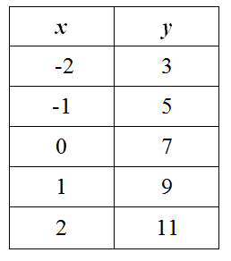
Grade 8 Patterns, Functions and Algebra
Determine the slope and y-intercept of a line with coordinates represented in the table. Write the equation of the line in y = mx + b form.

Slide 80
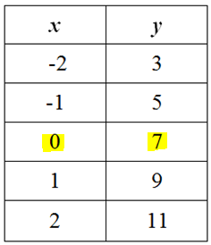
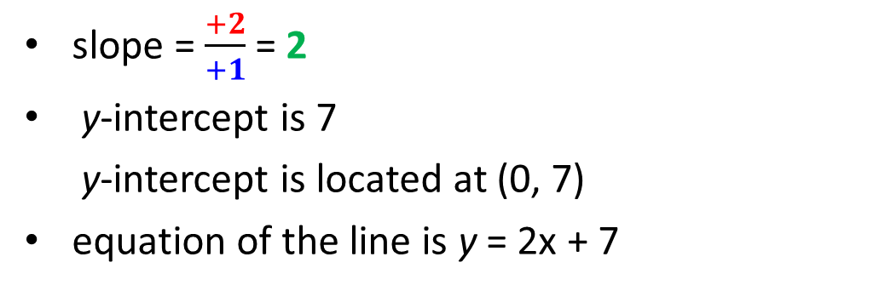
Grade 8 Patterns, Functions and Algebra
+1
+2
+1
+2
+1
+2
+1
+2
slope = $\frac{+2}{+1}$ = 2
y-intercept is 7
y-intercept is located at (0, 7)
equation of the line is y = 2x + 7

Slide 81
Grade 6 Revision Highlights
Operations with integers and practical problems
Lines of symmetry for regular polygons
Impact on measures of center when value is added, removed, or changed
Represent proportional relationships; unit rates; ratio tables; determine if a proportional relationship exists; and make connections between and among representations
Practical problems with one-step equations
Represent practical situations with inequalities; solve one-step inequalities using addition/subtraction and graph on a number line
Ballpark comparisons moved to Grade 7 (Computation and Estimation)
Volume and surface area of a rectangular prism included in Grade 7
Properties of quadrilaterals included in Grade 7
Probability moved to Grade 8
Arithmetic and geometric sequences removed

Slide 82
Grade 7 Revision Highlights
Solve practical problems involving operations with +/- rational numbers; Determine unknown side lengths/angle measures given similar quadrilaterals; solve a proportion to find a missing side length of similar quadrilaterals and triangles
Determine unknown side lengths/angle measures of quadrilaterals
Slope as rate of change; write an equation in y = mx form to represent a proportional relationship and y = x + b form to represent an additive relationship and graphs their lines; make connections between and among representations
Solve two-step inequalities and practical problems
Arithmetic and geometric sequences removed
Operations with integers moved to Grade 6
Describe how changing one attribute of a rectangular prism affects surface area and volume included in Grade 8
Dilations moved to Grade 7 and rotations included in HS Geometry

Slide 83
Grade 8 Revision Highlights
Use rational approximations of irrational numbers to compare and order
Determine measures of unknown angles using relationships between pairs of angles
Represent data in boxplots (box-and-whisker plots) and make inferences
Simplify algebraic expressions in one variable
Slope of a line given a graph; slope and y-intercept of a linear function and graph using y = mx + b form; make connections between and among representations
Solve multistep inequalities with variable on one or both sides of the inequality, including practical problems, and graph solution on a number line
Measure angles of less than 360° removed
Volume and surface area of triangular-based pyramids removed and rectangular prisms and cylinders included in Grade 7
Rotation and dilation from a fixed point (not the origin) moved to HS Geometry

Slide 84
Algebra I Revision Highlights
Simplify cube roots of all integers
Simplify numerical expressions containing square or cube roots, to include add/subtract/multiply two monomial square roots
Write the equation of a line parallel or perpendicular to a given line through a given point
Products of polynomials limited to five or fewer terms; factoring limited to one variable
Determine the equation of best fit limited to using a graphing utility
Detect patterns in data and represent with arithmetic and geometric patterns algebraically included in AFDA and AII
Interpret variation to include mean absolute deviation, standard deviation, and z-scores included in AFDA and AII
Box-and-whisker plots moved to Grade 8

Slide 85
Implementation of the
2016 Standards

Slide 86
Anticipated Implementation Timeline
2016-2017 School Year – Curriculum Development VDOE staff provides a summary of the revisions to assist school divisions in incorporating the new standards into local written curricula for inclusion in the taught curricula during the 2017-2018 school year.
2017-2018 School Year – Crossover Year 2009 Mathematics Standards of Learning and 2016 Mathematics Standards of Learning are included in the written and taught curricula. Spring 2018 Standards of Learning assessments measure the 2009 Mathematics Standards of Learning and include field test items measuring the 2016 Mathematics Standards of Learning.
2018-2019 School Year – Full-Implementation Year Written and taught curricula reflect the 2016 Mathematics Standards of Learning. Standards of Learning assessments measure the 2016 Mathematics Standards of Learning.

Slide 87
Implementation Support
We all have a role in implementation:
Crosswalk (summary of revisions) documents – VDOE
Progressions – VDOE
Curriculum Development – Divisions
Professional Development – VDOE and Divisions
Resources – VDOE and Divisions
Implications for My Work – reflection
Notes:
Ask “how would you utilize the crosswalk (summary of revisions) documents” with teachers???

Slide 88
Please contact us!
Debra.Delozier@doe.virginia.gov
Tina.Mazzacane@doe.virginia.gov
Christa.Southall@doe.virginia.gov

